Slide 1
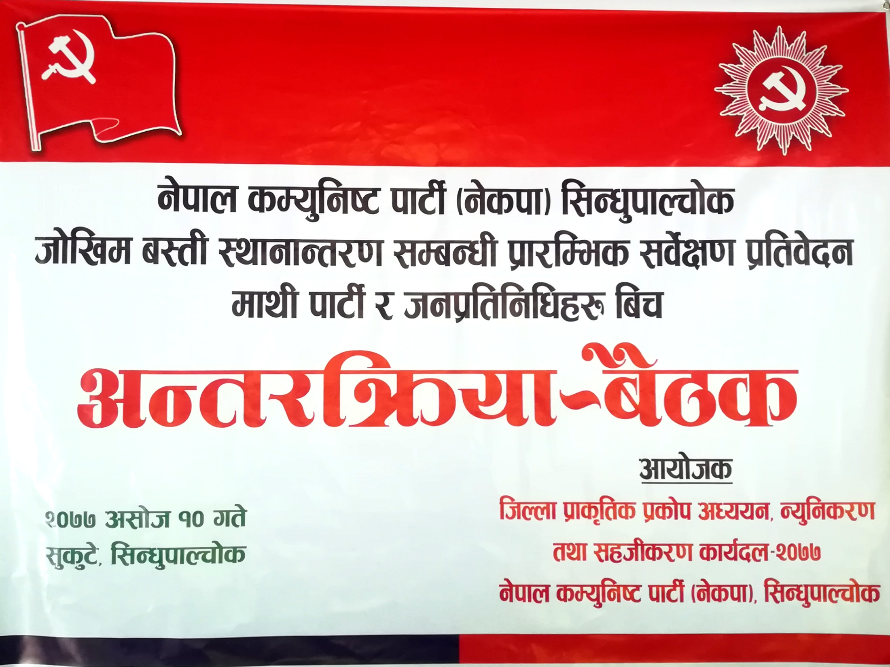

Slide 2


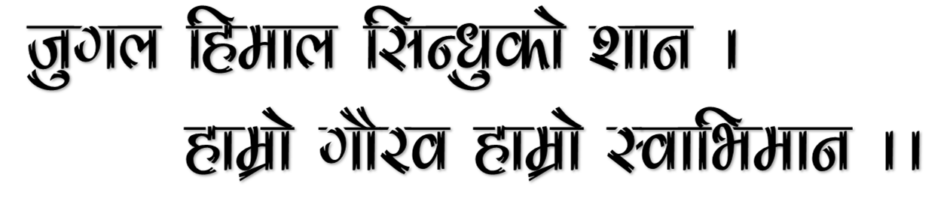
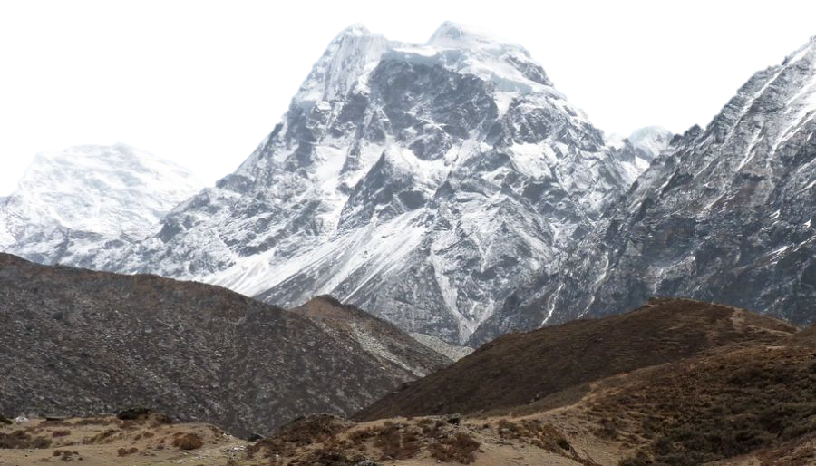

Slide 3
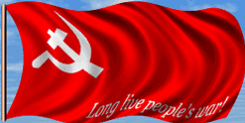
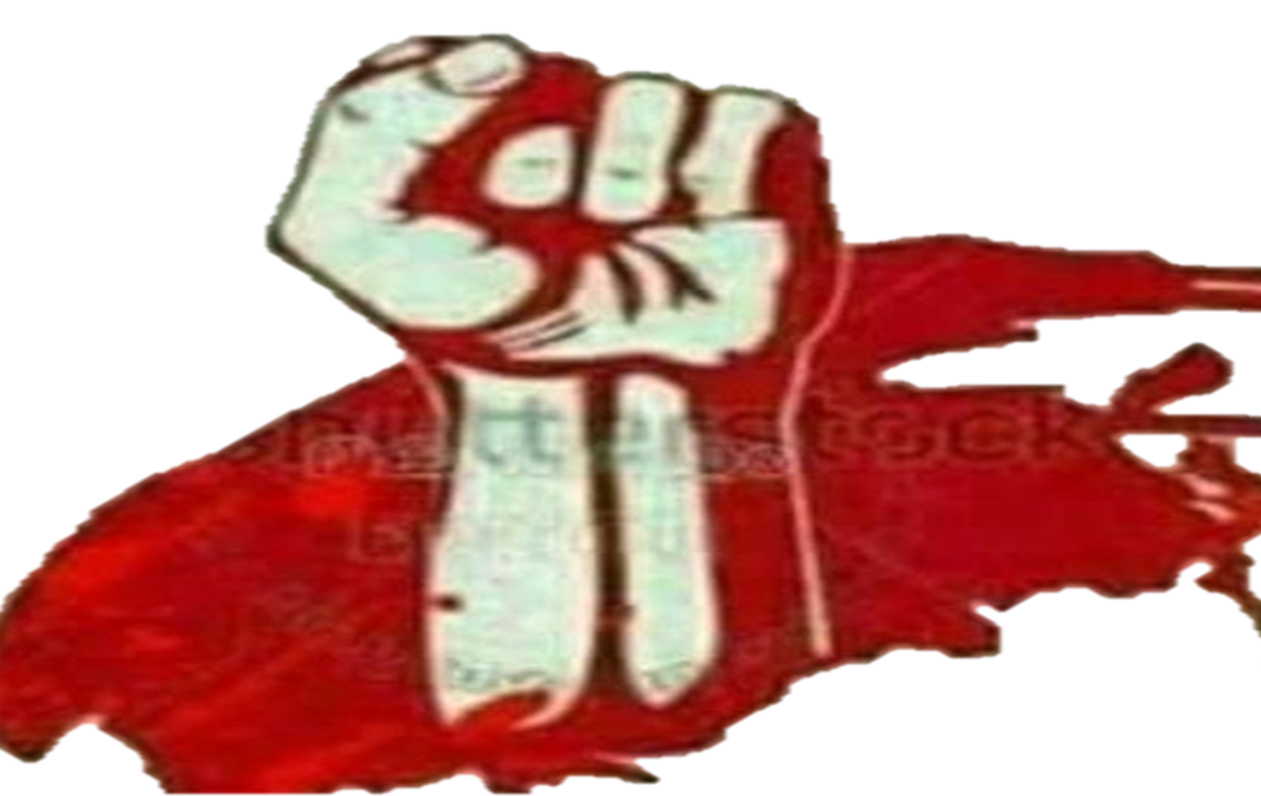

Slide 4
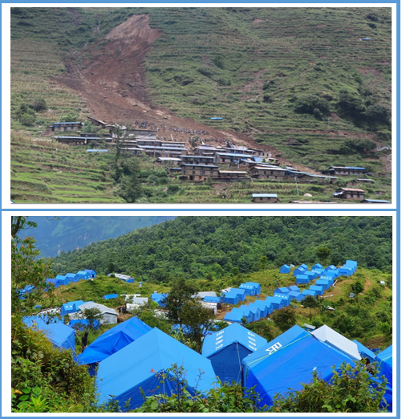

hf]lvd a:tL :yfgfGt/0f ;DaGwL k|f/lDes ;j{]If0f k|ltj]bg
k|ltj]bs
lhNnf k|s[lts k|sf]k cWoog,Go"lgs/0f tyf ;xlhs/0f
sfo{bn –@)&&
g]kfn sDo'lgi6 kf6L{ -g]skf_,l;Gw'kfNrf]s

Slide 5
laifo ;"rL
!=k[i7e"ld
@=sfo{bnsf] gfdfjnL
#=l;Gw'kfNrf]s lhNnfsf] ;+lIfKt kl/ro
$= k|fs[lts lakb\df l;Gw'kfNrf]s lhNnf
%= lhNnfdf ePsf s]xL d'Vo k|fs[lts lakb\x?
^= k|fs[lts lakb\sf sf/0f hf]lvddf /x]sf a:tLx?sf] laa/0f
&= xfn clt hf]lvddf /x]sf a:tL :yfgfGt/0fsf] k|f/lDes ;j]{If0f laa/0f
*=ljkb Joj:yfkgdf ePsf k|of;x?
(=k|fs[lts k|sf]k ;lxt ljkbsf 36gf x'g'sf k|d'v sf/0fx?
!)= lgisif{ / ;'emfj

Slide 6
!=k[i7e"ld
g]kfn sdhf]/ e"Mw/ftnLo agf]6, hnjfo' kl/j{tg, lg/Gt/ bf]xf]l//xg] jx' k|sf]ksf 36gf, c;+j]bglzn ljsf; lgdf{0f sfo{ nufotsf sf/0f pTkGg ljleGg k|fs[lts tyf u}/ k|fs[lts ljkbsf] cToflws hf]lvddf /x]sf] d'n's xf] . g]kfn ljZjdf e"sDkLo hf]lvdsf] b[li6n] P3f/f}+ tyf klx/f]sf] b[li6sf]0faf6 t]>f] clt hf]lvdo'Qm d'n'ssf] ?kdf /x]sf] 5 . jfudtL k|b]zdf /x]sf !# lhNnfx? dWo] l;Gw'kfNrf]s e"sDk, af9L,klx/f], cl;gf, r6\ofË h:tf k|fs[lts / ;8s b'3{6gf nufot dfgj l;lh{t ljkb\x?af6 ljkb\ hf]lvdsf b[li6n] ;+j]bgzLn tyf ax'k|sf]ksf] hf]lvdo'Qm lhNnfsf ?kdf /x]sf] 5 .
o; lhNnfdf klx/f],e"Ifo, af9L, r6\ofª, dxfdf/L, tyf 89]nf] / cfunfuL, xfjfx'/L, cl;gf, cflbaf6 jif]{gL ef}lts tyf dfgljo Iflt x'g] u/]sf] 5 . sdhf]/ e'jgf]6 / cJojl:yt ljsf;sf sfo{x?n] ubf{ klg ljkb\sf 36gfx? k|To]s jif{ a[l4 e}/x]sf 5g\ . lj=;+= @)&! ;fn ;fpg !& ut] l;Gw'kfNrf]ssf] h'/]df uPsf] klx/f]df k/L !%^ hgfn] Hofg u'dfP sof} hgf 3fOt] eP eg] ;of} kl/jf/ lj:yflkt eP .

Slide 7
o;}u/L uf]/vfsf] jf/kfs s]G›ljGb' eP/ uPsf] la=; @)&@ ;fnsf] e"sDkn] ;j}eGbf al9 dfgjLo tyf ef}lts Iflt klg l;Gw'kfNrf]s lhNnfdf g} eof] . lj=; @)&$ ;fnsf] aiff{bdf lrgsf] vf;f j/Lk/L 7"nf] aiff{b eof] / ef]6]sf]zLdf af9L cfP/ lhNnfsf] lnlkª,tftf]kfgL / sf]bf/L If]qdf 7"nf] ef}lts Iflt eof] . lj=; @)&%÷@)&^ df ;d]t 7'nf –7'nf ;8s b'3{6gf ;lxtsf u}/k|fs[lts ;lxt k|fs[lts ljkb\sf 36gf eP . lj=; @)&& sf] z'¿jft b]lv g} o; lhNnfsf ;j} :yfgLo txdf s'g} g s'g} k|sf/sf ljkb\sf 36gfx? eP . ljz]iful/ @)&& c;f9 @% ut] afx|la;] gu/kflnsfsf] hDa' / ef]6]sf]zL ufpkflnsfsf] gofF k'n, a'nsf]6] / nfrf{ If]qdf af9L klx/f] cfP/ dfgjLo / ef}lts Iflt eof] eg] c;f/ @^ ut] h'un uf=kf–@ ;fgf] gfDkmf, c;f/ @* ut] x]nDa' uf=kf– %af]Nb], ;fpg ( / !# ;'gsf]zL uf=kfsf] ;'Gb/8fF8f / w';]lgdf, ;fpg !* ut] d]nDrL gu/kflnsfsf] d]nDrL ahf/df ,;fpg !( ut] kfFrkf]v/L yfªkfn uf=kf– * ltk]gL , ;fpg #) ut] h'un uf=kfsf] lnbL / ebf} @*ut] afx|la;] gu/kflnsfsf] le/vs{ / gfuk'h]df af9L÷klx/f] cfP . ;j} 7fpF v08x/ h:t} ePsf 5g\ .

Slide 8
;Defljt ljkb\ hf]lvd Go'gLs/0f ub}{ dfgjLo, ef}lts, cfly{s, ;fdflhs, ;f+:s[lts tyf jftfj/0fLo Ifltdf sld Nofpgsf nflu lhNnfsf] hf]lvdo'Qm If]qsf] klxrfg ul/ lhNnfsf] ;du| j:t'l:yltnfO{ Wofgdf /fv]/ g]kfn sDo'lgi6 kf6L{ -g]skf_ l;Gw'kfNrf]s lhNnf kf6L{ sfo{nosf] @)&& ;fn h]i7 @% ut] a;]sf] a}7sn] ;f] ;DaGwdf cWoog ug]{ ljklQx?sf] sf/0f vf]lh u/L Go"lgs/0fsf] pkfox? ;d]t cWoog ub}{ k|ltj]bg tof/ kfg]{ / ;+3, k|b]z / :yflgo ;/sf/x? dfkm{t To;nfO{ sfo{Gjogdf n}hfg ;xhLs/0f ;d]t ug]{ p2]Zo /fv]/ ælhNnf k|fs[lts k|sf]k cWoog,Go"lgs/0f tyf ;xhLs/0f sfo{bn–@)&&, l;Gw'kfNrf]s” u7g ePsf] lyof] .o;af6 l;Gw'kfNrf]s lhNnfdf ljkbaf6 x'g ;Sg] ;+efljt hf]lvd klxrfg u/L k"j{tof/L, vf]h, p4f/, /fxt, k"g{:yfkgf, k"g{lgdf{0f u/L k|efjsf/L ljkb Joj:yfkg u/L Iflt sd ug]{ p2]Zo /x]sf] lyof] .

Slide 9
lj=; @)&& c;f/ !! ut] sfo{bnsf] klxnf] a}7s a;L sfo{ cf/De eO{;s]sf] lyof] . >[+vnfj4 ?kdf cfPsf ljklQx?sf] tTsfn vf]h, p4f/, /fxt, c:yfO{ af;:yfg nufotsf tTsflng sfo{x?df s]lG›t x'g'kg]{ l:ytL >[hgf eof] . ;f] sfo{df lhNnfsf] l;Ëf] kf6L{ k+lQm,:yflgo ;/sf/, kf6L{sf hglgjf{lrt k|ltlglwx?, hg;+u7g nufot ;Dk"0f{n] ;lqmotfk'j{s v6]/ kxnsbdL lnO{ ljkbsf] ;dodf ;d]t hgtfsf]df kf6L{sf] pkl:ylt k|efasf/L /Xof] .
tTsflng sfo{x?df s]lG›t x'g'kg]{ a:t'ut cfjZostfn] ljklQx?sf] sf/0f / Go"lgs/0fsf] pkfox?df ;'Id cWoog ug{ ;+ej ePsf] 5}g . klxnf] r/0f– vf]h, p4f/,/fxt / c:yfO{ Pj+ ;'/lIft :yfgdf a;f]af;sf] k|aGw, bf];|f] r/0f– hf]lvdo'Qm al:tx?sf] klxrfg / ;'/lIft :yfgdf :yfgfGt/0fsf] of]hgf lgdf0f{ / sfo{Gjog / t];|f] r/0f– elaiodf ljkb bf]xf]/Lg glbg Go"lgs/0fsf] pkfosf af/] cWoog, cGt/lqmof / 5nkmn dfkm{t k|ltj]bg tof/ kfg]{ u/L sfo{;'lr tof/ u/L sfo{bn lqmofzLn /x]sf] 5 .

Slide 10
ljutsf] ljkbaf6 k|fKt l;sfO{ tyf ljkb\ Joj:yfkg;+u ;DalGwt P]g, lgodnfO{ kl/rfng u/L sfo{ ug{' cfjZos 5 . :yfgLo txdf ;d]t ljkb\ Joj:yfkgsf nflu :yfgLo:t/sf] k|sf]k klxrfg, k|sf]k ;"rs gS;f tof/L, k|sf]k / ljkb\sf] n]vfhf]vf, k|sf]k k|efj ljZn]if0f, Iflt Go"gLs/0f of]hgf cfbL, of]hgf lgdf{0f ubf{ sfof{Gjogdf of]ubfg k'of{¥pg ;Sb5 .
ljkbsf sf/0f hf]lvddf k/]sf a:tLx?nfO{ ;'/lIft :yfgdf bLw{sflng ?kdf hLljsf]kfh{gsf] of]hgf ;lxt a:tL :yfgfGt/0fsf nfuL k|f/lDes ?kdf :yflgo ;/sf/x?, kf6L{ k+lQmsf] l;kmf/L;, sfo{bnsf] :ynut cWoog, lhNnf ljkb Joa:yfkg ;ldlt dfkm{t k|fKt ;xof]u / d'Vot lhNnf ;dGjo ;ldlt, l;=kf ;lxt ;j} ;/f]sf/jfnfsf] ;xof]udf of] k|f/lDes k|ltj]bg tof/ ul/Psf] 5 .
lhNnf k|fs[lts k|sf]k cWoog,Go"lgs/0f tyf ;xhLs/0f sfo{bn–@)&&
g]kfn sDo'lgi6 kf6L{ -g]skf_,l;Gw'kfNrf]s

Slide 11
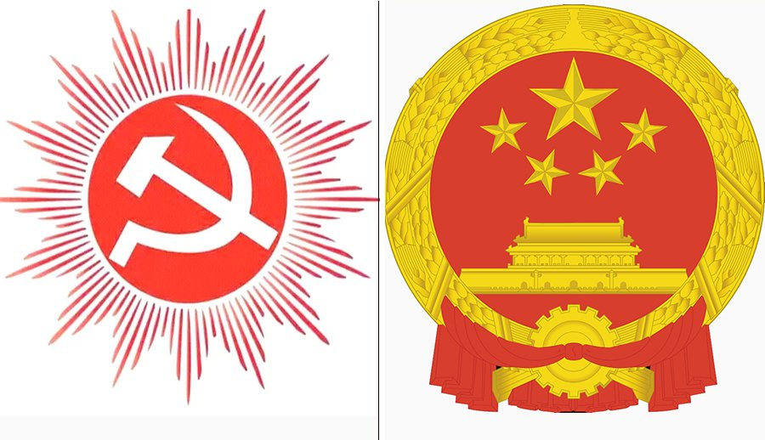
lhNnf k|fs[lts k|sf]k cWoog,Go"lgs/0f tyf ;xhLs/0f sfo{bn– @)&&, l;Gw'kfNrf]s
!_ ;+of]hs – dfwa ;fksf]6f…;'af]wÚ – s]lGb|o ;b:o
@_ ;b:o – bfjf tfdfª – s]lGb|o ;b:o ÷ lhNnf ;lrj
#_ ;b:o – ;'efif sd{rfo{ –k'j{ ;f+;b Pj+ afudtL k|b]z ;lrjfno ;b:o
$_ ;b:o – emDs g]kfn – lhNnf kf6L{ cWoIf
%_ ;b:o – ;/n ;xofqL kf}8\ofn – afudtL k|b]z ;lrjfno ;b:o
^_ ;b:o – s[i0f uf]kfn tfdfª – lhNnf ;dGjo ;ldlt k|d'v
&_ ;b:o – uDeL/nfn >]i7 – O{lGhlgo/÷lhNnf ;b:o

Slide 12
#= l;Gw'kfNrf]s lhNnfsf] ;+lIfKt kl/ro M
s_ ef}uf]lns cjl:ylt M
s=!_ cjl:ylt
cIffFz M @&⁾ @&Ú pQ/b]lv @*^{)­} !#Ú pQ/;Dd
b]zfGt/ M *%⁾ @&Ú k"j{b]lv *^⁾ )^Ú k"j{;Dd
s=@_ If]qkmn
g]kfnsf] s'n e' efusf] M !=&# k|ltzt
s'n If]qkmn M @%$@ ju{ ls=ld=
s=#_ ljefhg
k|b]z M afudtL
lhNnf M l;Gw'kfNrf]s
;+3Lo lgjf{rg If]q M @
k|b]z lgjf{rg If]q M $
:yfgLo tx M !@
gu/kflnsf M #
ufpFkflnsf M (
;b/d'sfd M rf}tf/f

Slide 13
s=$_ lhNnfsf] ;Ldf / cf};t nDafO{ rf}8fO{
k"j{ M bf]nvf lhNnf / rLgsf] :jzfl;t If]q ltAjt
klZrd M g'jfsf]6 / /;'jf lhNnf
pQ/ M /;'jf lhNnf / rLgsf] :jzfl;t If]q ltAjt
blIf0f M sfe|]knf~rf]s, sf7df8f}+ / /fd]5fk lhNnfx¿
k"j{ klZrd cf};t rf}8fO{ M $(=#* ls=ld=
pt/ blIf0f cf};t nDafO{ M %#=)^ ls=ld=
v_ P]ltxfl;s b:tfj]h M

Slide 14
la=;+= @)!* ;fnsf] k|zf;lgs laefhgdf k'j{ o; lhNnfsf e"–efux? k"j{ ! g+= If]q cGtu{t kb{Yof] . k"j{ ! g+= cGtu{t xfnsf l;Gw'kfNrf]s / sfe|]knf~rf]s lhNnfsf] ;b/d'sfd kb{y] . OltxfF; cg';f/ k"j{ ! g+= If]qsf @* df}hfx? /x]sf lyP h;sf] ;b/d'sfd rf}tf/f /x]sf] tYo+s kfO{G5 . l;Gw'kfNrf]s lhNnfdf /x]sf] æl;Gw'Æ / ækfNrf]sÆ ljutdf b'O{ dxTjk"0f{ y'dx? /x]sf] / ;f] :yfgsf] gfdnfO{ ldnfP/ lhNnfsf] gfdfs/0f l;Gw'kfNrf]s ePsf] xf] eGg] egfO{ /xL cfPsf] 5 .
wfld{s dxTj ;d]t af]s]sf] ækfNrf]sÆ y'ddf kfNrf]s eujtLdfO{ /x]sf]n] pQm :yfg wfld{s tyf ko{6sLo b[li6sf]0fn] clt g} rlr{t /x]sf] 5 h'g xfn x]nDa' ufpFkflnsfdf kb{5 . d]nDrL gu/kflnsfdf kg]{ æl;Gw'Æ g]kfnsf] k|frLg Oltxf;df sflGtk'/af6 cnu /fHosf] k|zf;lgs s]Gb|sf] gfdaf6 kl/lrt /x]sf] kfO{G5 . g]kfn / ltAat aLr Jofkfl/s dfu{sf] ?kdf ;d]t l;Gw'n] dxTj kfPsf] kfO{G5 . lnR5jL ;d|f6 c+z'adf{sL 5f]/L e[s'6Lsf] ljjfx kZrft\ ltAat hfg] qmddf oxL dfu{ x'b} uPsf] eGg] egfO{ /x]sf] kfO{G5 . o; lhNnfsf] ;b/d'sfd rf}tf/fsf] gfdfs/0f ;DaGwdf k|rlnt tYo, k|df0f / k"j{hx?sf] egfO{ cg';f/ /fhwfgL cf;kf;af6 dflg;x? ef]6tkm{ g'g lng hfg] qmddf ef/L la;fO{ ysfO{ dfg]{ / /ft k/]df ;f]xL rf}tf/Ldf af; a:g] ePsf]n] o; lhNnfsf] ;b/d'sfdsf] gfd rf}tf/f /xg uPsf] xf] eGg] egfO{ 5 .

Slide 15
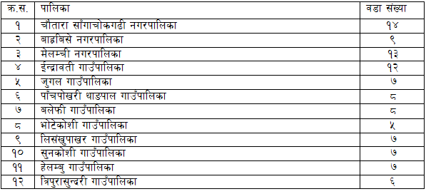
u_ k|zfiflgs tyf /fhg}lts ;+/rgf M
la=;+= @)&# kmfNu'g @& ;Dd o; lhNnfdf @ gu/kflnsf / ^& ufla;x? /x]sf lyP . tTkZrft\ gofF ;+/rgf cg';f/ la=;+= @)&# kmfNu'g @& ut] g]kfn ;/sf/n] /fhkqdf k|sflzt ul/ o; lhNnfnfO{ !@ j6f gofF :yfgLo txdf laefhg u/]sf] 5 . g]kfn ;/sf/sf] @)&# kmfNu'g @& ut] k|sflzt /fhkqdf pNn]v eP cg';f/ o; l;Gw'kfNrf]s lhNnfdf b]xfosf gu/kflnsf tyf ufpFkflnsf / j8fx? sfod ePsf] 5 .

Slide 16
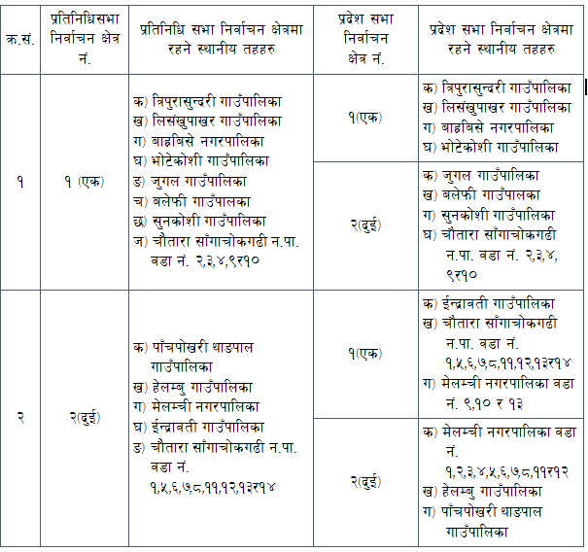
o; lhNnfnfO{ @ j6f k|ltlglw ;ef lgjf{rg If]q / $ j6f k|b]z ;ef lgjf{rg If]q sfod u/]sf] 5 . h;cg';f/ k|ltlglw ;ef tyf k|b]z ;ef lgjf{rg If]qdf /x]sf :yfgLo txx? b]xfo cg';f/ 5g\ .

Slide 17
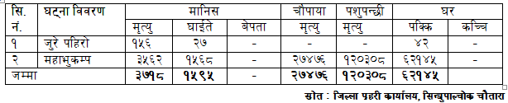
$= k|fs[lts lakb\df l;Gw'kfNrf]s lhNnf M
k|fs[lts ?kn] ;'Gb/ /x]sf] o; lhNnfn] aif]{gL cg]sg k|fs[lts lakb\ ;Fu h'b\b} cfO/xg' k/]sf] 5 . laut s]xL aif{otf o; lhNnfn] x/]s aif{ k|fs[lts lakb\sf sf/0f w]/} dfgjLo tyf ef}lts Iflt ;d]t Aoxf]g'{ k/]sf] 5 . o;} ;Gbe{df lhNnfn] ;fdgf u/]sf k|fs[lts lakb\x? / o;af6 ePsf Ifltsf] ;f/f+z oxfF k|:t't ul/Psf] 5 .
$=! l;Gw'kfNrf]s lhNnfdf ePsf] @ 7'nf dxflakb\df ePsf] Iflt laa/0f M

Slide 18
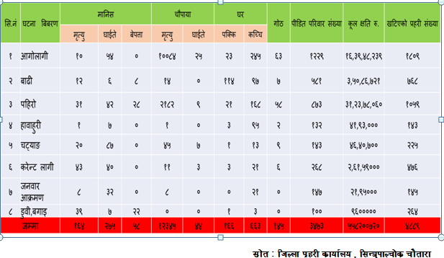
$=@ 7'nf dxflakb\ afx]s cf=j= @)&@÷)&# b]lv @)&&÷&* ;Dd % aif{df ePsf] Iflt laa/0f M

Slide 19
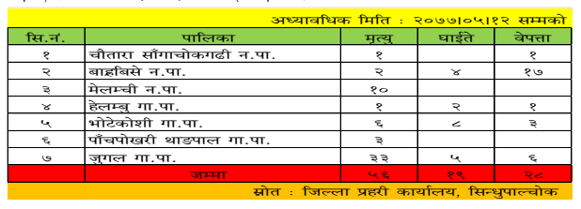
o; tYof+snfO{ x]bf{ laut ^ aif{df l;Gw'kfNrf]s lhNnfdf #**@ hgfsf] k|fs[lts lakb\sf] sf/0f d[To' ePsf] b]lvG5 eg] 3fOt] !*&) hgf b]lvG5 . o;sf ;fy} e'sDksf] sf/0f c/af} a/fa/sf] ef}lts Iflt ePsf] 5 eg] laut h'/] klx/f] / dxfe'sDk afx]s %% s/f]8 *@ nfv a/fa/sf] cfly{s Iflt ePsf] tYof+sn] b]vfPsf] 5 .
o; aif{sf] c;f/ dlxgf cyf{t @)&& c;f/ @@ ut] otf ePsf] k|fs[lts lakb\sf] sf/0fn] %^ hgfsf] d[To' ePsf] , @* hgf a]kQf /x]sf] / !( hgf 3fOt] ePsf] 5 .

Slide 20
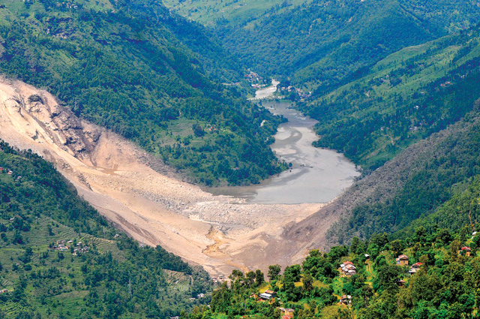
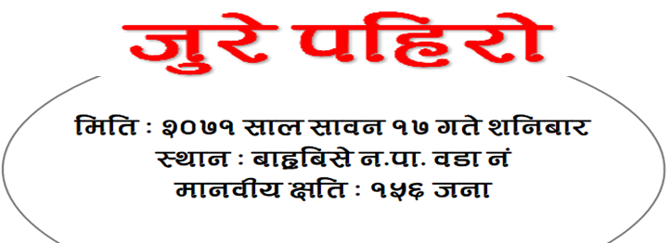
%= l;Gw'kfNrf]s lhNnfdf ePsf s]xL d'Vo k|fs[lts ljkb\x? M
o; klx/f]df kl/ kl/jf/ tyf cljefjs u'dfO{ 3/jf/ ljlxg ePsfx?nfO{ xfn ;Dd ljleGg lgsfox?af6 k|fKt ePsf] /fxt jfkt /sd kfpg ;s]sf] 5}g .

Slide 21
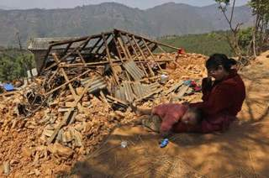
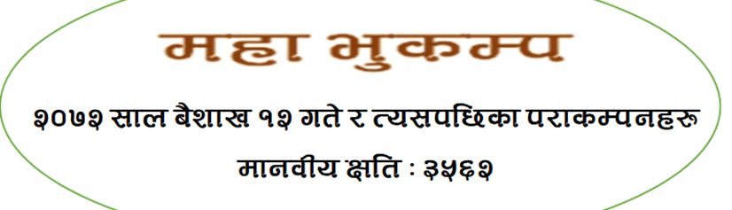
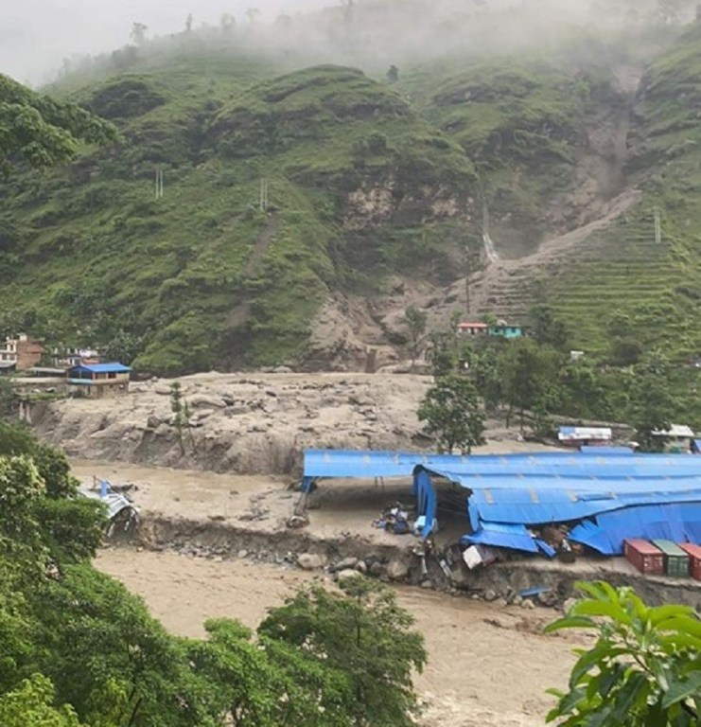
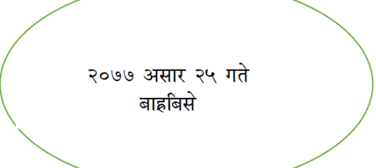
lglh cfjf;x? jlg ;s]klg s]lx ;fdflhs ;+/rgfx? cem} aGg afFsL b]lvG5 .
hDa' klx/f]

Slide 22

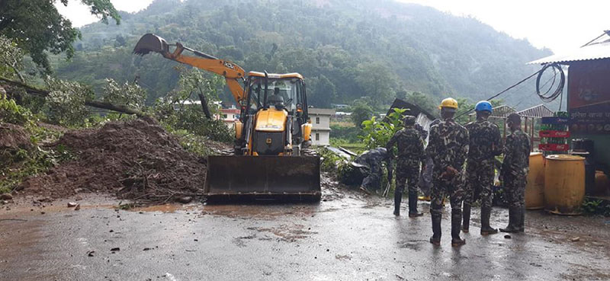
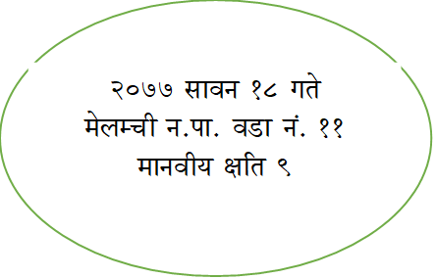
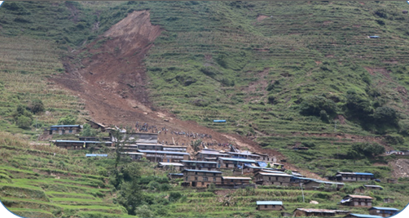
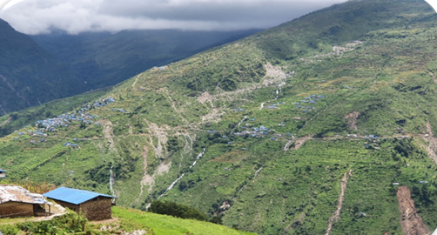
lnbL klx/f]
@)&& ;fpg #) ut]
h'un ufFpkflnsf j8f g+–@
dfgjLo IftLM #( hgf
h'un ufFpkflnsf j8f g+–# af]Nb]
b]lvPsf] kfgL e+ufnf] kl/ hldg d'gL l5/]sf] / j:tLnfO{ :yfoL :yfgfGt/0f ug'{kg]{ .
hf]lvd 3/ M @^)

Slide 23
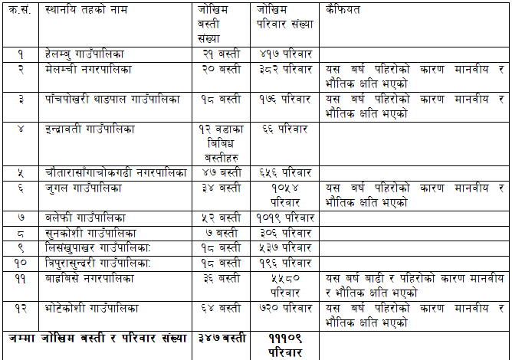
^= lhNnfdf /x]sf hf]lvdo'Qm a:tLx?sf] laa/0f M
o; l;Gw'kfNrf]s lhNnfdf /x]sf hf]lvdo'Qm a:tLx?sf] ;DaGwdf :yfgLo txx?n] pknAw u/fOPsf] laa/0f o; k|sf/ /x]sf] 5 .

Slide 24
&= clt hf]lvddf k/]sf / tTsfn :yfgfGt/0f ug{' kg]{ a:tLx?sf] k|fl/lDes ;j]{If0f M
&=! M clt hf]lvd a:tLsf] xfnsf] l:ylt
l;=g+= | hf]lvd a:tLsf] gfd | uf=kf=÷g=kf / j8f g+= | sf/0f | dfgjLo Iflt | lakb ldlt | 3/w'/L | s}lkmot
! | lnbL | h'un uf=kf= – @ | klx/f] | #( | @)&&.)$.#) | !&@ | Klx/f]n] a:tL g} 5f]k]sf]
@ | gfDkmf | h'un uf=kf= – @ | klx/f] |  |  | @( | Hfldgdf lr/f lr/f k/]sf] / efl:;Psf]
# | af]Nb] | h'un uf=kf= – # | klx/f] |  |  | @^) | Hfldgdf lr/f lr/f k/]sf] / efl:;Psf]
$ | nfrf{ | ef]6]sf]lz uf=kf= –# | klx/f] |  |  | &% | Hfldgdf lr/f lr/f k/]sf] / efl:;Psf]
% | hDa' | afx|la;] g=kf= – % | klx/f] | @) | @)&&.)#.@% | @# | klx/f] / af9Ln] a:tL k'/]sf]
^ | 7'nf] ysgL | d]nDrL g=kf= – $ | klx/f] |  |  | !) | klx/f] a:tL glhs k'u]sf]
& | cdn] | d]nDrL g=kf= – $ | klx/f] |  |  | !% | klx/f] a:tL glhs k'u]sf]
* | af]Nb] | x]nDa' uf=kf= % | klx/f] |  |  | ^% | Hfldgdf lr/f lr/f k/]sf] / efl:;Psf]

Slide 25
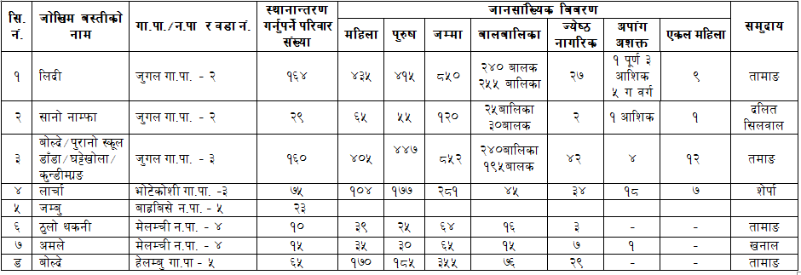
&=@ clt hf]lvd a:tLsf] xfnsf] hg;+lVosLo ca:yf M

Slide 26
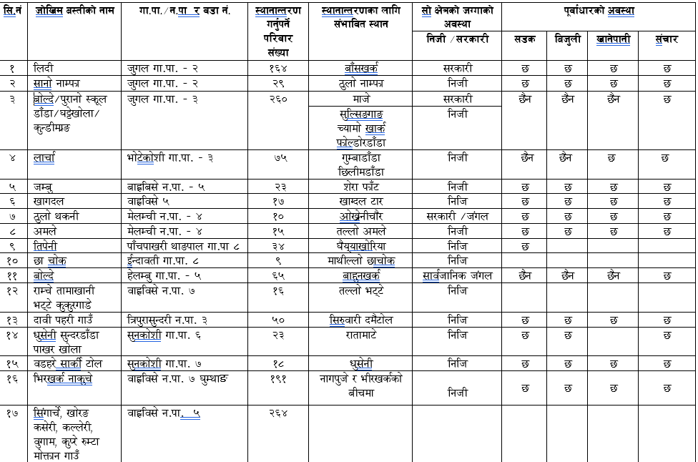
&=# :yfgfGt/0fsf nflu ;+efljt :yfgx?sf] ca:yf M

Slide 27
*=ljkt Joa:yfkgdf ePsf k|of;x? M
;a} ;fgf–7"nf 36gfx?df tTsfn kf6L{ g]t[Tj, hgk|ltlglwx?, :yflgo ;/sf/, kf6L{ ;Da4 hg;+u7gx?sf] vf]h, p4f/, /fxt, c:yfO{ a;f]af; nufotsf ;jfnx?df ;lqmotfk'j{s 36gf:ynx?df k'u]/ kxnsbdL lnO{ lakbdf kf6L{ / ;/sf/sf] k|ToIf pkl:ytLsf] k|Tofe"t u/fpg ;kmn ePsf] 5 . Sltko kflnsfx?df k|f/lDes r/0fdf ;dGjosf] sdL /x] t/ cfwf/e't ?kdf kf6L{ / :yflgo ;/sf/x? ;+o'Qm ?kdf g} lqmoflzn /x]sf 5g\ . h;n] lakbdf ;d]t kf6L{ / ;/sf/ hgtf ;u}+ /xL b'Mvdf ;fy lbPsf] ;Gb]z uPsf] 5 .
laleGg ljkbx?df 3fOt] ePsf !#hgf gfu/Lsx?nfO{ x]lnsK6/,PDa'n]G; nufotsf ;fwgx?sf] kl/rfng ub}{ p4f/ u/L] plrt pkrf/sf] Joa:yf ul/Psf] 5 .
lnbL klx/f]df cleefas u'dfPsf & hgf afnaflnsfx?nfO{ kf6L{sf] kxn / ;Ddfglgo ;efd'v cUgL k|;fb ;fksf]6fsf] g]t[Tjdf P;cf]P; afnu|fddf Joa:yfkg ul/Psf] 5 .

Slide 28
lnbL klx/f]df cleefas u'dfPsf & hgf afnaflnsfx?nfO{ kf6L{sf] kxn / ;Ddfglgo ;efd'v cUgL k|;fb ;fksf]6fsf] g]t[Tjdf P;cf]P; afnu|fddf Joa:yfkg ul/Psf] 5 .
af9L klx/f]sf sf/0f 3/af/ lalxg ePsf / pRr hf]lvddf /x]sf 3/w'/Lsf gfu/Lsx?sf nflu 6]G6, lqkfn / cGo nh]:6Ls ;fdfu|Lsf] Joa:yf u/L kf6L{sf] ;xof]u,;dGjo / :yflgo ;/sf/sf] g]t[Tjdf c:yfO{ a;f]af;sf] Joa:yf ldnfO{Psf] 5 .
ldlt @)&& ebf} * ut] ;Ddfglgo ;efd'v cUgL k|;fb ;fksf]6fsf] kxndf l;Gw'kfNrf]ssf af9L / klx/f] ;DaGwdf l;+xb/af/df pRr:t/Lo a}7ssf] cfof]hgf ug{' eof] . la:yflktx?sf nfuL tTsfn c:yfO{ a;f]af;sf] Joa:yf ug]{ . a:tLx?sf] cWoogsf nfuL k|fljlws 6f]nL k7fpg] / /fli6«o ljkb\ hf]lvd Go"lgs/0f tyf Joj:yfkg k|flws/0fn] tTsfnLg /fxtsf] Joa:yf ug]{ . hf]lvdo'Qm a:tLaf6 :yfgfGt/0f ul/g] kl/jf/sf nfuL :yfgLo txn] ;'/lIft hUuf Joa:yfkgsf] sfd ug]{ . l;Gw'kfNrf]s lhNnf nfO{ ljkb Joj:yfkgdf b]zs} gd"gf lhNnfsf ?kdf ljsf; ug{ cfjZos u[xsfo{ ;lxt tof/L ug]{ .

Slide 29
5nkmndf h'/] klx/f] kLl8tsf nfuL ;a{;fwf/0faf6 ;+sng eO{ /fHo sf]ifdf /x]sf] /sd oyfzLw| lgsf;f ug]{, l;Gw'kfNrf]sdf la:yflktx?sf] :yfoL a;f]af;sf nfuL Plss[t df]8]n agfpg] / c/lgsf] /fhdfu{ tTsfn ;~rfngdf Nofpg] lgisif{ lgsflnPsf]] lyof] . 5nkmndf u[xdGqL /fd axfb'/ yfkf, cy{dGqL 8f= o'j/fh vltj8f,ef}lts k"jf{wf/ tyf oftfoft dGqL a;Gt s'df/ g]Djfª, afudtL k|b]zsf d'VodGqL 8f]/dl0f kf}8]n, l;Gw'kfNrf]s If]q g+ @ sf ;f+;b z]/axfb'/ tfdfªsf] ;xefuLtf /x]sf] lyof] . To:t} afudtL k|b]zsf pBf]u,ko{6g tyf jftfj/0f dGqL c?0f g]kfn, afudtL k|b]z ;efsf] cy{ tyf ljsf; ;ldltsf ;efklt ;/]z g]kfn, /fli6«o k'glg{df0f k|flws/0fsf k|d'v sfo{sf/L clws[t ;'zLn 1jfnL, ef}lts k"jf{wf/ tyf oftfoft dGqfnosf ;lrj b]a]Gb| sfsL{, /fli6«o ljkb hf]lvd Go"lgs/0f tyf Joj:yfkg k|flws/0fsf k|d'v clgn kf]v/]n, lhNnf ;dGjo ;ldlt l;Gw'kfNrf]ssf k|d'v s[i0f uf]kfn tfdfª ;lxt g]kfn sDo'lgi6 kf6L{ -g]skf_ l;Gw'kfNrf]s sf ;x–O{~rfh{ dfwa ;fksf]6f…;'af]wÚ, afx|la;] gu/kflnsfsf k|d'v lgdkm'Ghf] z]kf{, h'un ufFpkflnsfsf cWoIf xf]d gf/fo0f >]i7 / ef]6]sf]zL ufFpkflnsfsf cWoIf /fhs'df/ kf}8]nsf] klg pkl:ylt /x]sf] lyof] .

Slide 30
h'/] klx/f] lkl8tsf] nfuL hDdf ePsf] /sd lhNnf ljkb Joa:yfkg ;ldltsf] vftfdf /f]Ssf /x]sf] 5 . ;f] /sd lkl8tx? nfO{ ljt/0f ug{sf nflu cfaZos kxnsbdL cl3 a9fO{Psf] 5 .
af9L klx/f]n] la:yflkt a:tLx? lnbL,hDa',nfrf{,gfkmf,ltk]gL,af]Nb] nufotsf :yfgx?df sfo{bnsf] tkm{af6 :ynut cWoog, ;/f]sf/jfnf lkl8tx? ;+u 5nkmn cGt/lqmof u/L a:tL :yfgfGt/0fsf nfuL ;Deflat :ynx?sf] vf]hL ug}{ / ;dGjo Pj+ ;xhLs/0fsf] sfd ug]{ u/L kLl8tx?sf] k|ltlglw /x]sf] :yflgo :t/df ;ldltx? lgdf{0f u/L sfo{ hf/L /x]sf] 5 .
(=k|fs[lts k|sf]k ;lxt ljkbsf 36gf x'g'sf k|d'v sf/0fx? M
s=ljkb hf]lvd Go'gLs/0f / ljsf; lgdf{0f sfo{aLr cfjZos tfnd]nsf] sdL x'g'
v=sdhf]/ e"–agf]6 , le/fnf] / pRr kxf8 /xg' .
u=k|fs[lts ;|f]tx?sf] cJojl:yt tyf cToflws bf]xg x'g' .

Slide 31
3= hf]lvdo'Qm / Go'gtd dfkb08 gk'u]sf u|fld0f ;8s lgdf{0f x'g' .
ª= e'Mpkof]u of]hgf , ejg ;+lxtf lgdf{0f / sfof{Gjog gx'g' .
r=Plss[t ;'rgf k|0ffnLsf] cefj x'g' .
5= ;+s6 cf+sngsf] k"j{d"NofÍg gx'g' .
h=cJojl:yt ?kdf a:tL÷;x/Ls/0f lj:tf/ x'g' .
em=cfktsfnLg cj:yfsf nflu bIf / oy]:6 dfgj ;f|]t , pks/0f ,aGbf]a:tL / /fxt ;fdfu|Lsf] sld x'g' .
`= cGt/lgsfo ;+3 k|b]z / :yfgLo txalr 7f8f] -Vertical_ / t];f]{ -Horizontal_ ?kdf k|efjsf/L ;dGjosf] sdL x'g' .
6= ;+3, k|b]z / :yflgo ;/sf/x?n] dfkb08 adf]lhdsf ;jf/L ;fwgx? ;~rfng / Joj:yfkgdf kof{Kt Wofg glbg' .
7= hg;d'bfodf ljkb hf]lvd Go"lgs/0f, ljkb k|ltsfo{,ljkb k'g{ngfesf] sfo{df ;+a]bglzn gb]lvg' .

Slide 32
!)= lgisif{ / ;'emfjx? M
l;Gw'kfNrf]s lhNnf k|fs[lts k|sf]ksf sf/0f dfgljo tyf ef}lts Iflt x'g] klxnf] lhNnfsf] ?kdf lrlgPsf] 5 . x/]s ;fn o; lhNnfdf k|fslts k|sf]ksf sf/0f 7"nf] wghgsf] IftL ePsf] 5 . b]zs} lglDt k|fs[lts k|sf]k tyf dfgj l;lh{t ljkbx?sf] Go'lgs/0f / Joj:yfkg clxn]sf] d'Vo r'gf}ltsf] ?kdf /x]sf] 5 .
e'sDk kZrft x/]s jif{ k|fs[lts ljkltsf sf/0f cy{tGqdf ;d]t uDeL/ gsf/fTds c;/ kg{uPsf] 5 t;y{ lakb\ hf]lvdo'Qm a:tLx?sf] klxrfg ug]{ / :yfgfGt/0fsf nflu ;+efljt ;'/lIft :yfgsf] klxrfg ul/ ;f]sf] ef}uf]lns, ;fdflhs, cfly{s nufotsf kIfx?sf] cWoog ul/ ;DaGwLt a:tLx?nfO{ ;'/lIft :yfgdf :yfgfGt/0f ug]{ sfd cfhsf] k|d'v bfloTj x'g cfPsf] 5 .

Slide 33
a:tL :yfgfGt/0fsf] laifo ;lhnf] kSs} 5}g . o;sf nflu ef}uf]lns, ;fdflhs,;fF:s[lts ,efjgfTds / cfly{s kIfx?sf] plrt ;Daf]wg x'g h?/L 5 . o;f] gx'Fbf a:tL :yfgfGt/0f u/]klg tL a:tLx? bLuf] ?kdf :yflkt x'g ;s]sf] 5}gg\ . @)&@ ;fndf uPsf] dxfe'sDkdf kZrft\ lnbLa:tL h'unsf] afF;vs{df c:yfoL ?kn] cfP/ a;]sf lyP . ;f] a:tLsf] cfocfh{g / lhljsf]kfh{g ;d]tsf] of]hgf x'g g;Sbf lnbLaf;L k'g lnbL g} kmls{g k/]sf] lyof] . o;y{ a:tL :yfgfGt/0f u/L :yfoL a;f]af;sf] Aoa:yfkg ug]{ ;Gbe{df b]xfosf cfwf/e"t tTjx?nfO{ ;Daf]wg ug{ ;s] dfq jl:t :yfgGt/0fsf] of]hgf ;kmn x'g] b]lvG5 .
;'/lIft hldgsf] klxrfg
cfocfh{g÷ hLlasf]kfh{gsf] j}1flgs, Jojxfl/s / ;DaGwLt hgtfx?sf] ;d]t ;xefuLtfdf :ki6 of]hgf lgdf{0f ug'{kg]{ .
hUuf ;§fk§fsf] Aoa:yf ug'{kg]{ .

Slide 34
;fljs a:tLsf] emNsf] lbg] u/L ;fdflhs,;Ff:s[lts / efagfTds kIfx?sf] ;d]t larf/ u/L :yfgfGt/0fs]f of]hgf lgdf0f{ ug'{ kg]{ .
cfwf/e't k"jf{wf/ - ;8s, lzIff,:jf:Yo,vfg]kfgL, laB't, ;+rf/, v]ns'b cflb_sf] Joj:yf x'g' kg]{ .
;'emfa M
xfn klxrfg ePsf hf]lvdo'Qm a:tLx? / ;f] a:tLsf] :yfgfGt/0fsf nflu pko'Qm :yfg klxrfg ug{ oyfl;3| e"ue{lab\ tyf la1 6f]nL4f/f cWoog u/L ;/f]sf/jfnf :yflgo hgtfx?;+u yk k/fdz{ u/L :yfgfGt/0fsf :yfgx? klxrfg u/L tTsfn lgisif{df k'Ug' kg{] .
k|fs[lts lakb\sf sf/0f hf]lvd a:tL :yfgfGt/0f u/L PsLs[t a:tL lgdf{0fsf ;Gbe{df cfjZos kg]{ sfg"g lgdf{0f ug'{kg]{ . sfg"g lgdf{0f ubf{ e"uf]nsf] dfq laifodf s]lGb|t g/xL :yfgfGt/0f x'g] a:tLdf a:g] hf]lvd a:tLsf kl/jf/sf] kfl/jfl/s, cfly{s, ;fdflhs lasf; tyf ;'/Iff nufotsf laifodf plrt k|aGw x'g] ul/ sfg"g lgdf{0f ug{ cfjZos .

Slide 35
sfg'gL hl6ntf / emd]nfsf sf/0f hgtfsf] efjgf cg'?ksf] a:tL ljsf;sf ;fy} cfocfh{g / hLlasf]kfh{g nufPtsf ;jfnx?df of]hgf sfo{Gjogdf r'gf}tL >[hgf x'g] / hgtfx? lg/fz eP/ k'gMk'/fg} hf]lvdo'Qm ynf]df g} kms{g] / b'3{6gfx? bf]xf]l/g] vt/f 5 . To;}n] To;sf] ;xh ;dfwfgsf] nfuL sfg'gsf 1ftf / lj1x?sf] ;'efa cg';f/– ljkb ;+s6u|:t If]q 3f]if0ff u/L ;xh÷Jojxf/Ls sfo{ljlw lgdf{0f u/L sfo{Gjogdf hfFbf of]hgf lgdf{0f / sfo{Gjog ;xh x'g]5 .
lglZrt a:tLx?sf] 5gf]6 u/L k'jf{wf/,a:tL ljsf;,cfocfh{g÷ hLljsf]kfh{g, ;/sf/L ;]jf k|jfx nfufotsf laifox?df s]lGb|t u/L cAan -Role model_ a:tLx? ljsf; ug{] / b]ze/L efaL lbgx?df To;nfO{ la:tf/ ug{ ;Sg] u/L ;kmn df]8]n a:tL ljsf;df ;+3Lo / k|b]z ;/sf/sf] Wofg s]lGb|t ug'{ kg]{ .

Slide 36

wGojfb clejfbg

